Slide 1
Mental Health eScreening
OEF/OIF/OND Care Management Team Clinician Training
December 12, 2014

Slide 2
Introduction to the eScreening tablet system
Mental Health eScreening Research Pilot
For the last two years, members of the Center for Excellence in Stress and Mental Health (CESAMH) have been using eScreening for OEF/OIF/OND Veterans enrolling in VA Health Care in San Diego. CESAMH has also been tracking OOO Veterans for depression, suicide risk, PTSD, and more.
We (CESAMH) found that about half of the newly enrolled had risk factors for suicide, indicating the need for immediate clinical follow-up. Many of them had symptoms of depression or anxiety, and the majority of these younger Veterans were in physical pain.

Slide 3
Benefits of using eScreening
We have compared screening times between Veterans using paper packet forms versus Veterans using CESAMH tablets to self-assess during enrollment. We found that almost all of the tablet-using Veterans had their screenings documented an average of 19 days sooner than the Veterans who used paper packet forms.
This is a fantastic leap forward in patient care.
We have the cutting edge technology, but without you, we can’t make the process successful. We are asking you to work with us as we roll out a new, upgraded, tablet system with a faster and more user-friendly interface.

Slide 4
The New System
*It’s an upgraded tablet system with a faster and more user-friendly interface.
*We believe we can achieve the same positive results in other clinics while at the same time minimizing the workload that is already required of staff.
Findings from the Research Pilot
eScreening:
was preferred by both Clinicians and Veterans
increased access to mental and physical health screening
allowed for timely triage to appropriate services without increasing staff (approximately 40% of Vets need immediate follow-up with the Suicide Risk Assessment)
created significant improvement in many areas of clinical care
Has far-reaching implications for how technology can streamline screening for mental and physical health needs in healthcare systems.

Slide 5
Training Modules
Today’s Training Covers:
Overview 5 minutes
Setting Up a Battery of Screens 4 minutes
Reporting and Data 1 minute
Troubleshooting & Additional Support 1 minute
User Roles, Permissions, & Security 2 minutes
Dashboard Features 6 minutes
1
2
3
4
5
6

Slide 6
1 | Overview
What is Mental Health eScreening (MHE)?
It’s an electronic assessment system that automates the manual, paper-based process used for initial screening of Veterans in VA healthcare settings.
MHE enables Veterans to complete self-assessments on a tablet or PC while in a clinic.
MHE accelerates patient enrollment by allowing clinicians to oversee the patient-directed screening with real-time scoring, chart note generation, and if pre-determined parameters are exceeded, immediate crisis alerts.
Goals
Facilitate comprehensive mental health screening for newly enrolling Veterans nationwide.
Increase the number of Veterans receiving mental health services.
Improve patient engagement and satisfaction, without an increase in staff and resources.
Gather health data and share with clinicians to improve care delivery to Veterans.

Slide 7
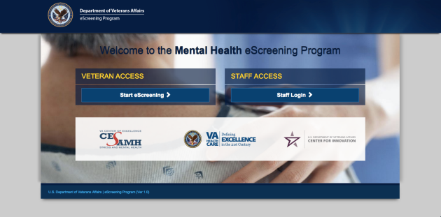
1 | Accessing the application
Access the MHE application with a tablet or a PC, by typing the web address into your browser’s URL field: http://vaww.escreening.va.gov/sd/
The address will be added to the Shared Drive.
The Welcome screen opens:

Slide 8
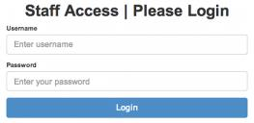

1 | Logging in
Click Staff Login >. The Staff Access | Please Login opens:
Type your user name and password, then click Login.
Your Home page opens:

Slide 9

1 | Logging out
Click Logout. The system logs you out.
Automatic logout
If you are inactive for 20 minutes, the system will warn that you have 20 seconds before an automatic logout. You must interact with the program if you want to keep your session open. If the system logs you out but you want to keep working, simply log in again.

Slide 10
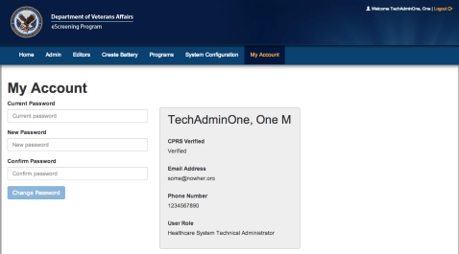
1 | Changing your password
From your Home page, click My Account. The My Account tab opens.
Type your current password.
Type and re-type your new password, then click Change Password. The system updates your password.

Slide 11
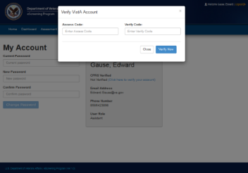
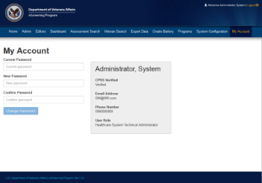
1 | Verifying your CPRS Account
The My Accounts page is also where you verify your CPRS Account (one-time only).
Click Click here to verify your account.
Type your Access and Verify Codes.
Click Verify Now.
Log out, then log back in. Your account is verified.

Slide 12
Training Modules
Today’s Training Covers:
Overview 5 minutes
Setting Up a Battery of Screens 4 minutes
Reporting and Data 1 minute
Troubleshooting & Additional Support 1 minute
User Roles, Permissions, & Security 2 minutes
Dashboard Features 6 minutes
1
2
3
4
5
6

Slide 13
2 | User roles and permissions
MHE System Roles
Consultation and Program Evaluation Administrator
Healthcare System Technical Administrator
Clinician
Assistant
Veteran
Reporting and Metrics
Extracts clinical Battery data from the eScreening database for all sites, to:
identify trends and compare them for program and progress evaluation, and
provide feedback for improvement.
Technical Support
Edits and assigns users;
manages system level settings.
Creates, edits, deletes, & uploads Batteries.
Manages Battery errors.
Completes forms and follow-ups.
Patient Care
Receives clinical data from CPRS.
Utilizes the health data collected through the eScreening application.
Monitors the Battery dashboard with alerts
Medical Support
Creates Batteries for Veterans to complete in the waiting room.
Can access the dashboard to finalize assessment.
The Patient
Completes the Screening Battery.

Slide 14
2 | User Management - Security
Tablets will not function outside of the hospital grounds.
Tablets have built-in tracking capability.
The system records the name and address of the last Veteran who used a missing tablet.
Staff will not be held responsible for tablets which are stolen or broken by a Veteran.

Slide 15
Training Modules
Today’s Training Covers:
Overview 5 minutes
Setting Up an Assessment 4 minutes
Reporting and Data 1 minute
Troubleshooting & Additional Support 1 minute
User Roles, Permissions, & Security 2 minutes
Dashboard Features 6 minutes
1
2
3
4
5
6

Slide 16
3 | Setting up Assessments
Assessments may be created in a batch for the next day’s appointments, or they may be created singly for a walk-in Veteran.
Before a Veteran can begin eScreening, one of these users must set up an assessment for the Veteran:
Healthcare System Technical Administrator,
Clinician (LVNs, RNs, NPs, MDs, etc.), or
Assistant (MSA, etc.)
Setting up an assessment consists of these procedures done in sequence:
Create a Veteran record (or locate one) in the database (DB).
Assign a new battery to the Veteran.
After A and B are complete, the system is ready to accept input on a tablet from the Veteran.

Slide 17

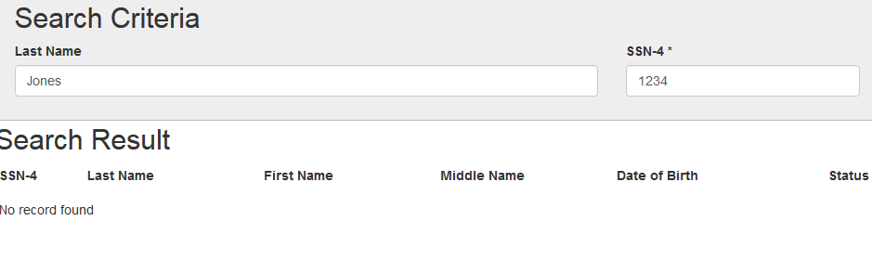
3 | Setting up a Battery of screens
A. Creating a Veteran Record in the DB
From the Home screen, click the Create Battery tab. The Select Veteran screen opens.
At this point we need to search VistA and CPRS to see if the Veteran has a record.
3. The search Results will tell us if a record is found.

Slide 18
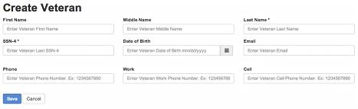
3 | Setting up a Battery of screens
A. Creating a Veteran Record in the DB
If a record is NOT found, click +Create Veteran Record in DB.
The Create Veteran screen opens:
Type the information, then click Save. Fields marked with an asterisk (*) are required. The Veteran Detail screen opens, showing a status that the Veteran exists in DB.

Slide 19
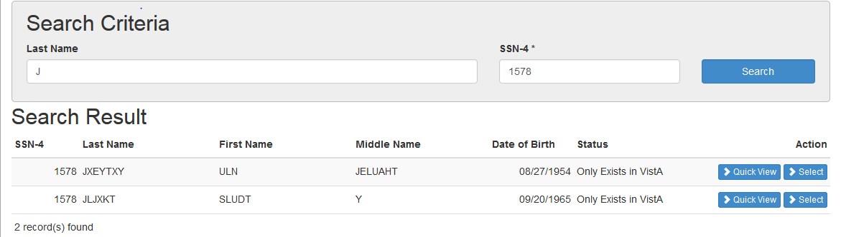
3 | Setting up a Battery of screens
A. Creating a Veteran Record in the DB
If a record IS found, we can verify that it is the Veteran we are eScreening.
Click Select by the Veteran’s name. The Create Veteran page opens.

Slide 20
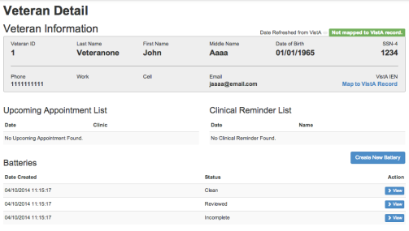
3 | Setting Up a Battery of Screens
B. Assigning a New Battery to a Veteran
Now you can assign a Battery for the Veteran to complete in the waiting room.
From the Veteran Detail screen, click Create New Battery.

Slide 21
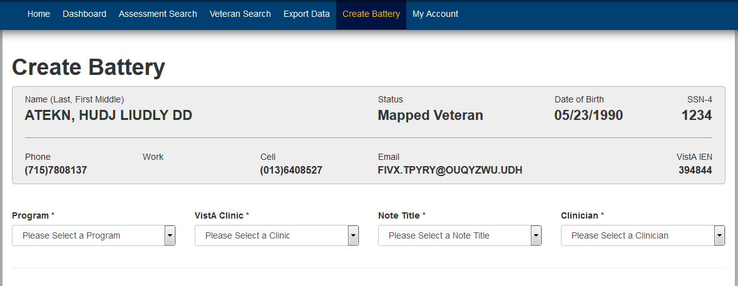
3 | Setting Up a Battery of Screens
B. Assigning a New Battery to a Veteran
The Create Battery page opens.
Click the lists and select your Program, Clinic, Note Title, and Clinician (who will receive the note).

Slide 22
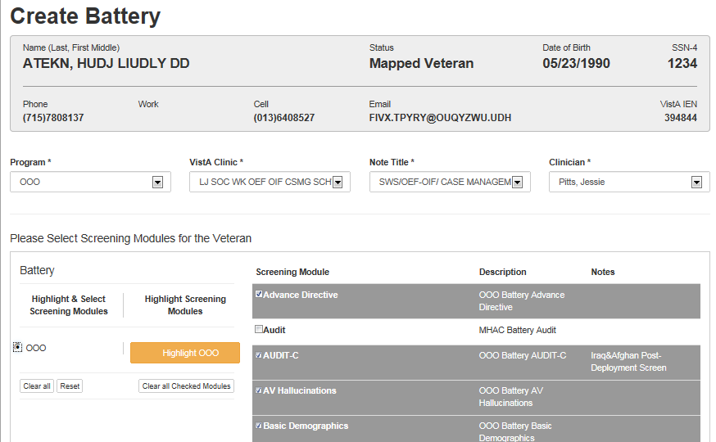
3 | Setting Up a Battery of Screens
B. Assigning a New Battery to a Veteran
Click the OEF/OIF/OND Intake Screen (OOO) option button, then scroll and view the pre-created batteries and modules available for the Veteran, then make any changes that you want.
Click Save. The system tells you that Battery creation was successful.

Slide 23
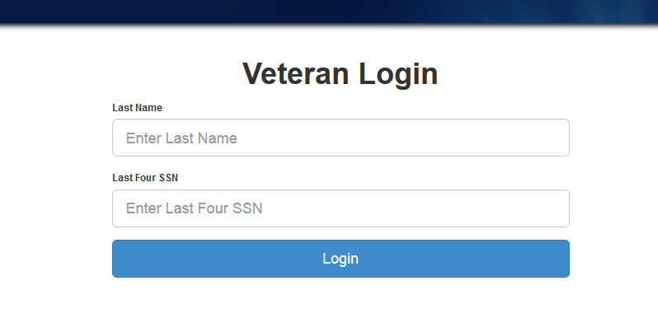
3 | Setting Up a Battery of Screens
B. Assigning a New Battery to a Veteran
The system is ready for the Veteran to log in and complete the Battery.

Slide 24
Training Modules
Today’s Training Covers:
Overview 5 minutes
Setting Up a Battery of Screens 4 minutes
Reporting and Data 1 minute
Troubleshooting & Additional Support 1 minute
User Roles, Permissions, & Security 2 minutes
Dashboard Features 6 minutes
1
2
3
4
5
6

Slide 25
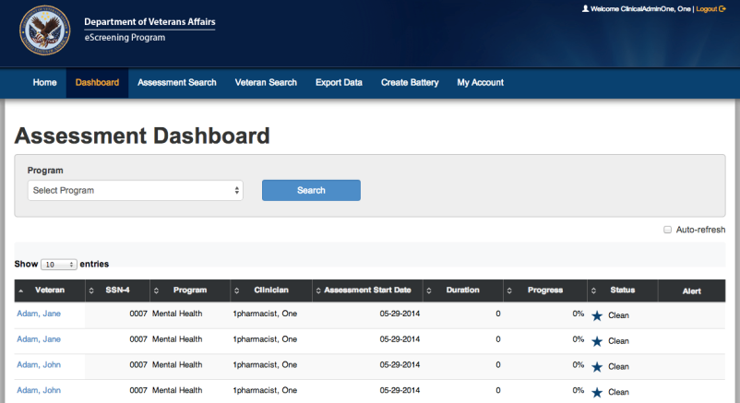
4 | Dashboard Features
From the Home screen, click Dashboard.
The Dashboard opens in List view.

Slide 26
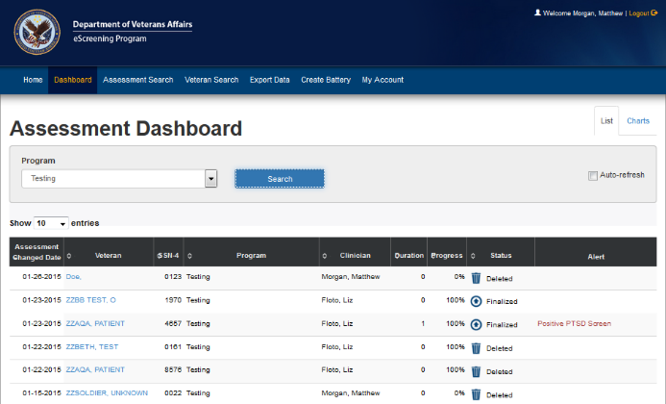
4 | Dashboard Features
The dashboard LIST View shows:
Which Veteran has a battery scheduled, in progress, or completed.
Any alerts associated with the screenings.
Clicking a Veteran’s name brings you to the Assessment Summary page (next slide).

Slide 27
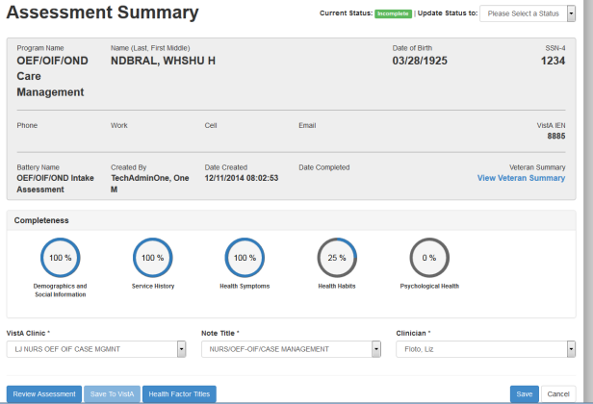
4 | Dashboard Features
Click Review Assessment to review the CPRS note.

Slide 28
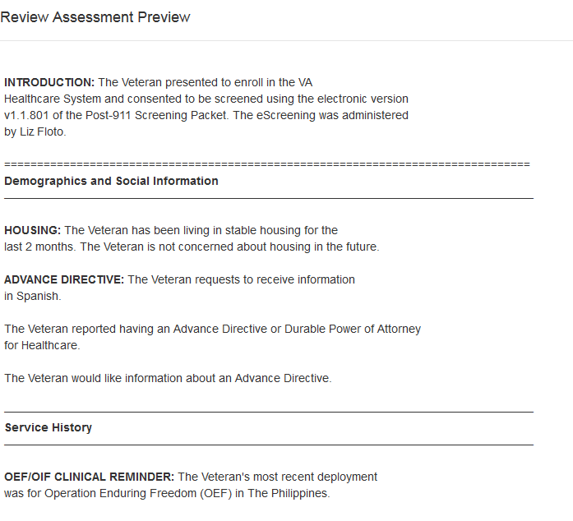
4 | Dashboard Features
The assessment preview opens:

Slide 29
4 | Dashboard Features
You can view and print the Veteran Summary.

Slide 30
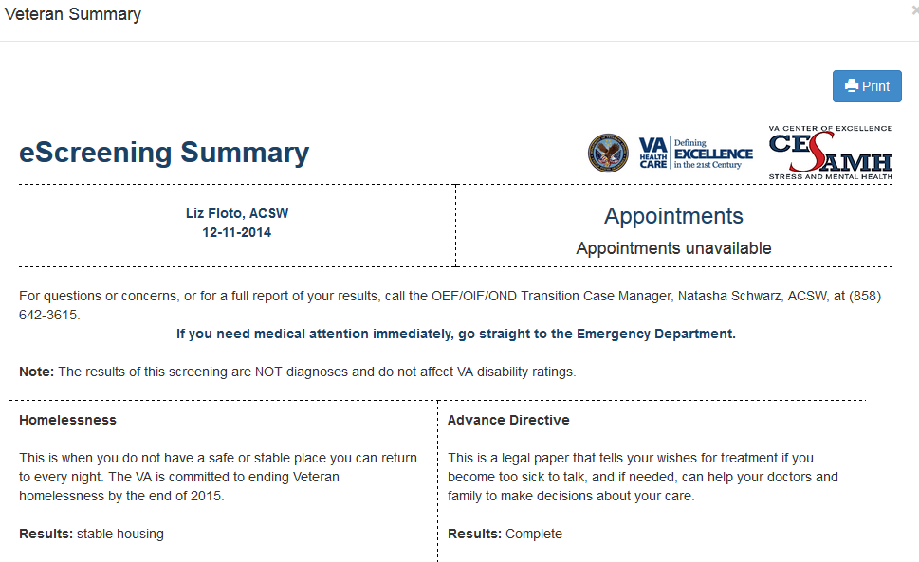
4 | Dashboard Features

Slide 31
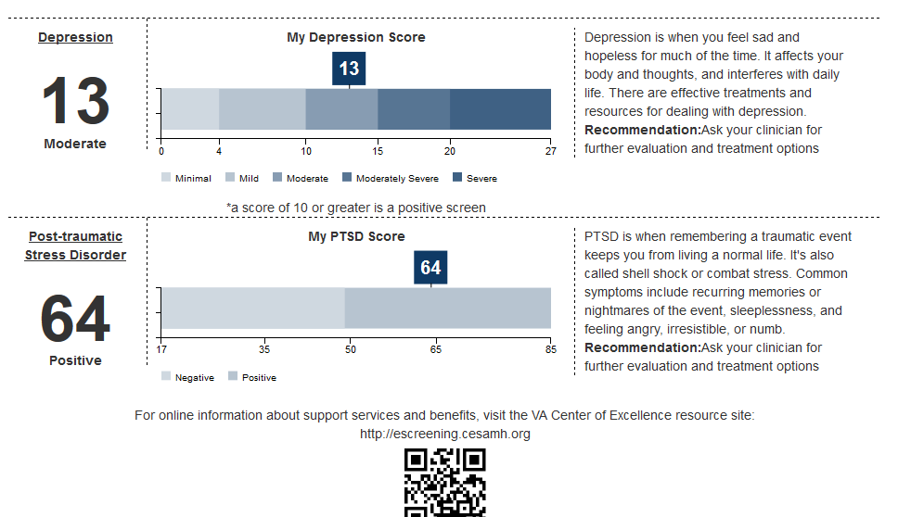
4 | Dashboard Features
eScreening Summary, continued

Slide 32
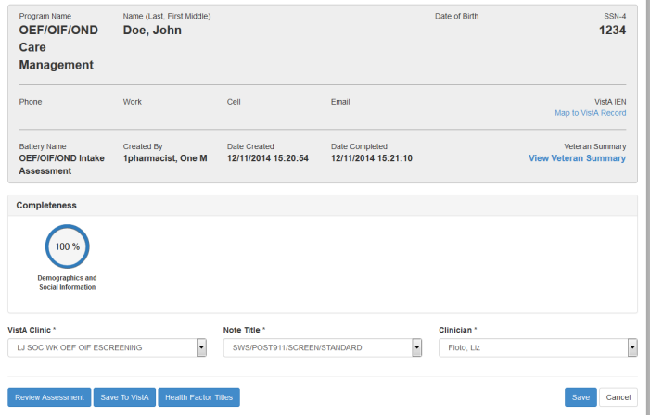
4| Dashboard Features
Map the Veteran’s assessment to their newly created VistA record – but only if the Veteran was NOT in CPRS/VistA before taking the assessment.

Slide 33
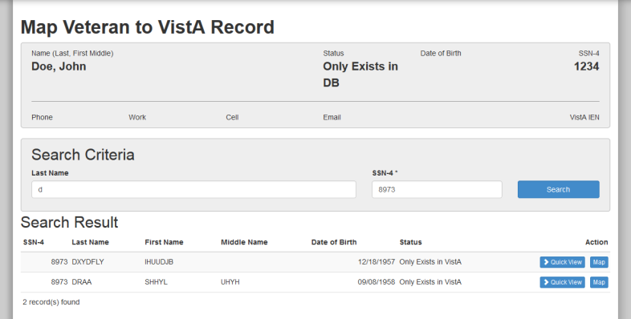
4| Dashboard Features
Map the Veteran ONLY if he was NOT in Vista/CPRS prior to taking the assessment

Slide 34
4 | Dashboard Features
If the assessment’s current status is Incomplete, you must update it to Complete before you click Save. After you click Save, the information is transmitted to CPRS.

Slide 35
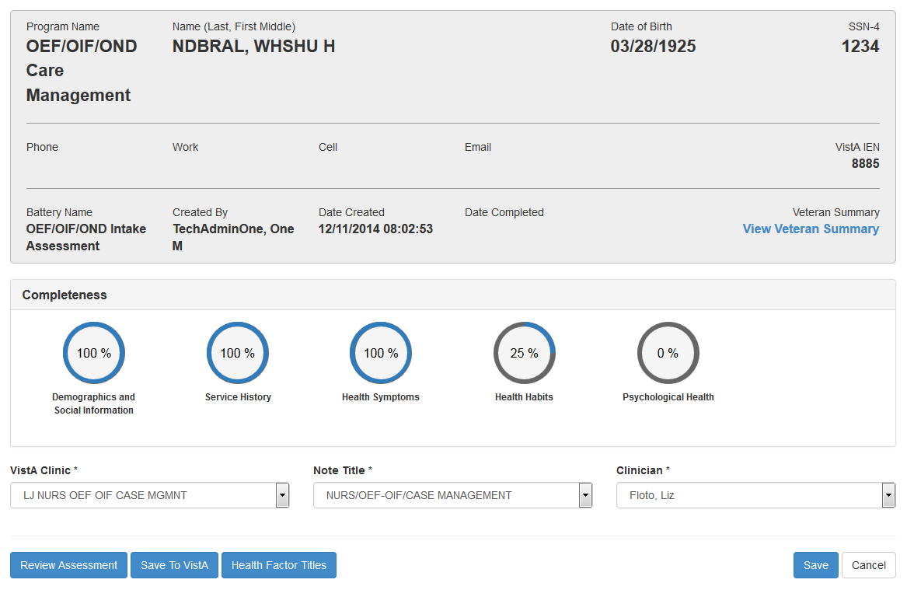
4 | Dashboard Features
You can also update the VistA Clinic, Note Title, and Clinician after the Veteran has finished the assessment.
1

Slide 36
4| Dashboard Features
This is also where a staff member must save the assessment to Vista/CPRS.

Slide 37
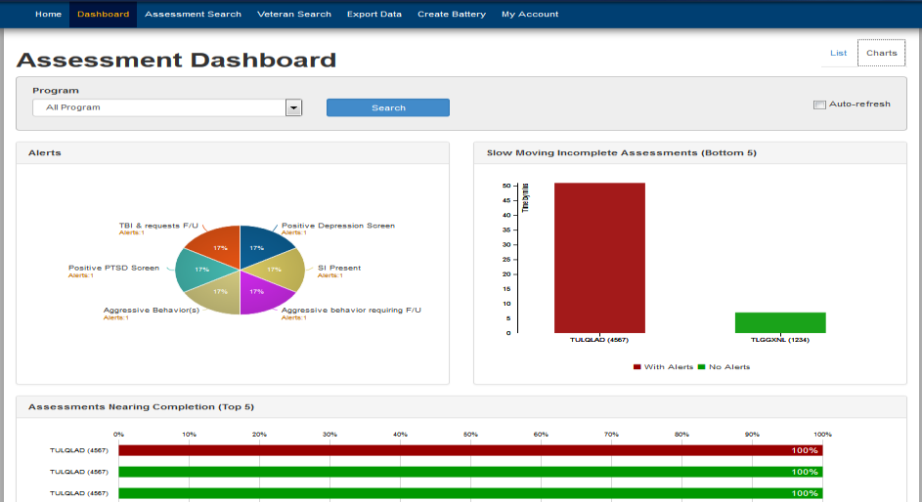
4 | Dashboard Features
The dashboard CHARTS View also shows:
Which Veteran has a battery scheduled, in progress, or completed.
Any alerts associated with the screenings.

Slide 38
Training Modules
Today’s Training Covers:
Overview 5 minutes
Setting Up a Battery of Screens 4 minutes
Reporting and Data 1 minute
Troubleshooting & Additional Support 1 minute
User Roles, Permissions, & Security 2 minutes
Dashboard Features 6 minutes
1
2
3
4
5
6

Slide 39
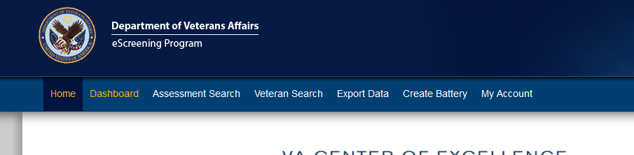
5| Reporting and Data
Introduction to Reporting and Data
MHE incorporates a number of functions that allow you to view Veteran and assessment data, and generate various reports.
You can:
Search the system for Veterans and Assessments.
Print or review a Veteran’s individual questions and answers.
Export data for program evaluation.

Slide 40
Training Modules
Today’s Training Covers:
Overview 5 minutes
Setting Up a Battery of Screens 4 minutes
Reporting and Data 1 minute
Troubleshooting & Additional Support 1 minute
User Roles, Permissions, & Security 2 minutes
Dashboard Features 6 minutes
1
2
3
4
5
6

Slide 41
6| Troubleshooting & Support
Additional Training
Supplemental and future trainings options:
Future refresher training, as needed
Review the User Training Manual
Contact your training resources:
Liz Floto
858-552-8585 Ext. 5550
Elizabeth.floto@va.gov
Matthew Morgan 858-552-8585 ext.5557
Matthew.Morgan@va.gov

Slide 42

How to create assessments
Go to: http://10.178.10.107:8080/escreeningdashboard-sd/
Click Staff Login >
Username: 1pharmacist
Password: password

Slide 43

OEF/OIF/OND Care Management Work Flow
1 Click Create Battery.

Slide 44
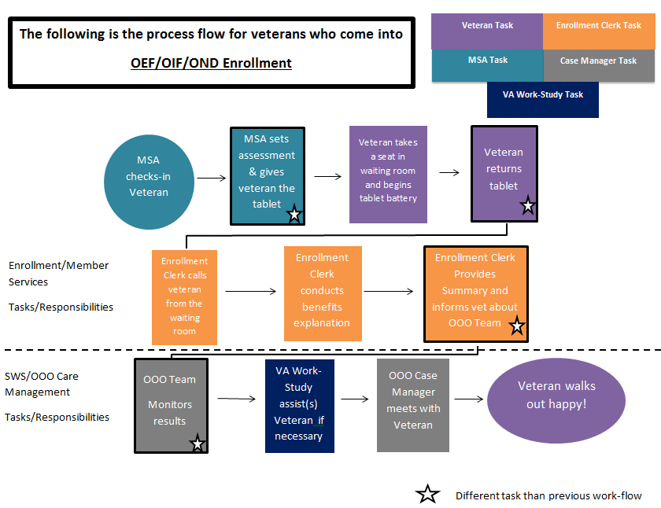
OEF/OIF/OND Care Management Work Flow

Slide 45
2 Veteran takes Assessment.

Slide 46
OEF/OIF/OND Care Management Work Flow

Slide 47
OEF/OIF/OND Care Management Work Flow
3 Print Veteran Summary.

Slide 48
OEF/OIF/OND Care Management Work Flow

Slide 49
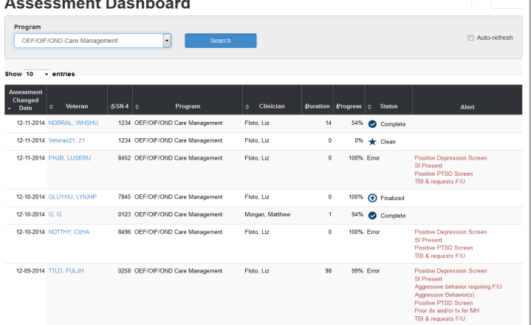
OEF/OIF/OND Care Management Work Flow
4 Monitor Assessments from Dashboard

Slide 50
OEF/OIF/OND Care Management Work Flow

Slide 51
OEF/OIF/OND Care Management Work Flow
5 Send Assessment to VistA/CPRS

Slide 52
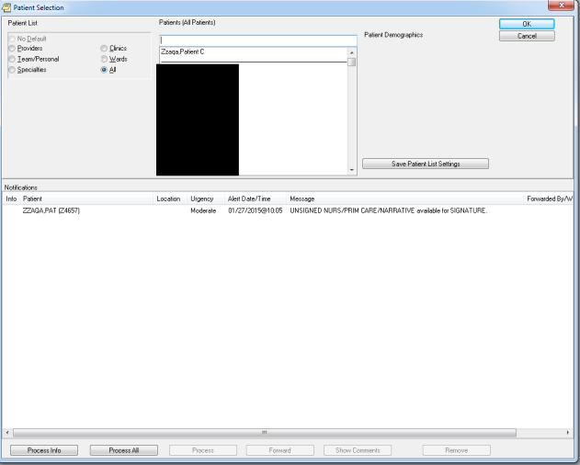
Using CPRS with eScreening
B. Alerting
After the information is sent to CPRS/VistA, a notification is generated

Slide 53
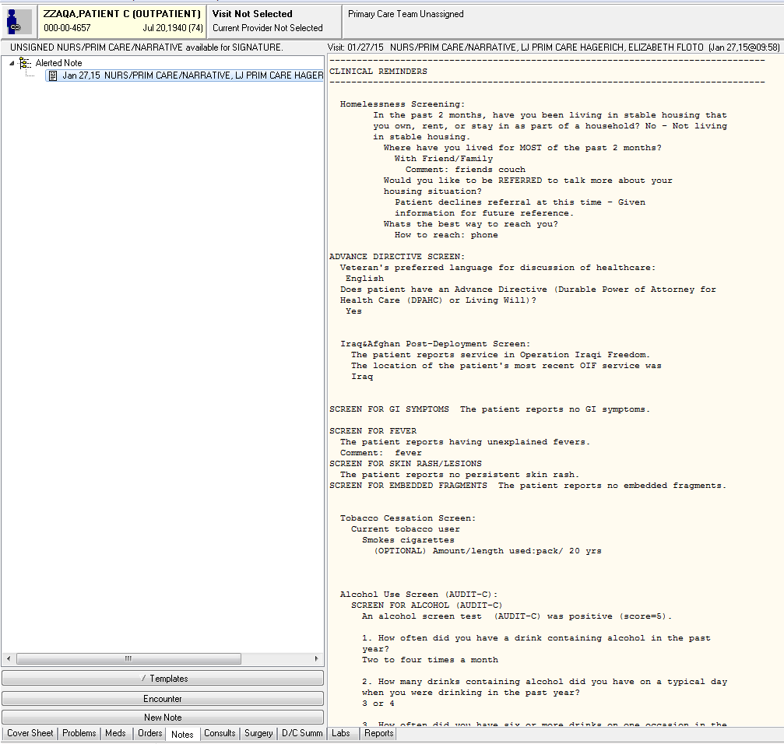
Using CPRS with eScreening
C. CPRS Note
eScreening begins your note and auto-populates the information the Veteran entered on the Tablet—including Clinical Reminders.

Slide 54
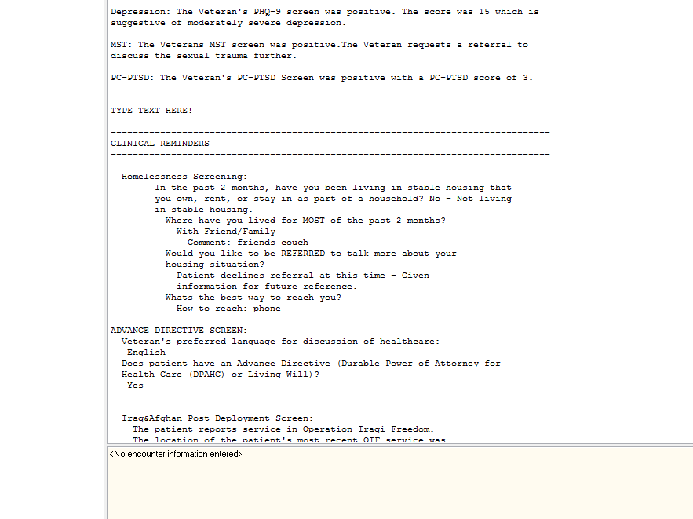
Using CPRS with eScreening
D. Editing the Note
Click Edit Note to add additional information to the note.

Slide 55
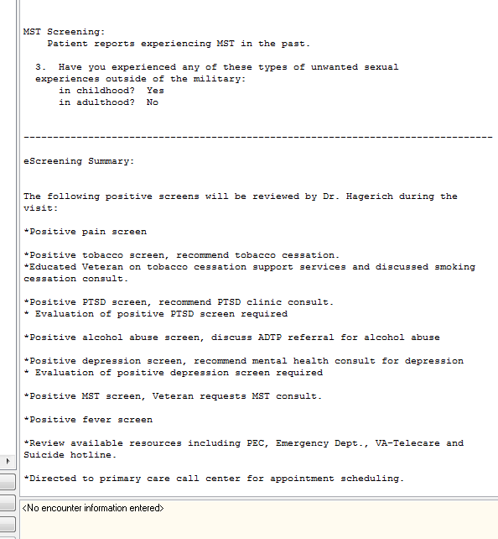
Using CPRS with eScreening
E. Footer
Any positive screens will be summarized in the bottom of the note for the Provider to attend to during the visit. You can add the Provider as a Cosigner as necessary.

Slide 56
OEF/OIF/OND Care Management Work Flow

Slide 57
Questions?

Slide 58
Thank you for attending the training!

